Slide 1
Micro Credit Defaulter
by Sinchana

Slide 2
I
Introduction

Slide 3
Introduction
A Microfinance Institution (MFI) is an organization that offers financial services to low income populations. MFS becomes very useful when targeting especially the unbanked poor families living in remote areas with not much sources of income.The Microfinance services (MFS) provided by MFI are Group Loans, Agricultural Loans, Individual Business Loans and so on.
Many microfinance institutions (MFI), experts and donors are supporting the idea of using mobile financial services (MFS)
which they feel are more convenient and efficient, and cost saving, than the traditional high-touch model used since long
for the purpose of delivering microfinance services. Though, the MFI industry is primarily focusing on low income families
and are very useful in such areas, the implementation of MFS has been uneven with both significant challenges and
successes.
We are working with one such client that is in Telecom Industry. They are a fixed wireless telecommunications network
provider. They have launched various products and have developed its business and organization based on the budget
operator model, offering better products at Lower Prices to all value conscious customers through a strategy of disruptive
innovation that focuses on the subscriber.
They are collaborating with an MFI to provide micro-credit on mobile balances to be paid back in 5 days. The Consumer is
believed to be defaulter if he deviates from the path of paying back the loaned amount within the time duration of 5 days.
For the loan amount of 5 (in Indonesian Rupiah), payback amount should be 6 (in Indonesian Rupiah), while, for the loan
amount of 10 (in Indonesian Rupiah), the payback amount should be 12 (in Indonesian Rupiah).

Slide 4
P
Problem statement

Slide 5
Problem statement
Build a model which can be used to predict in terms of a probability for each loan transaction, whether the customer will be paying back the loaned amount within 5 days of insurance of loan.
In this case, Label ‘1’ indicates that the loan has been payed i.e. Non- defaulter, while, Label ‘0’ indicates that the loan has not been payed i.e. defaulter.

Slide 6
Initial understanding of dataset
No Null values in the dataset
There may be some customers with no loan history.
On analysis we got that the dataset is imbalanced. Labe ’1’ has approximately 87.5% records, while, label ‘0’ has approximately 12.5% records.
For some features, there may be values which might not be realistic. we have to treated them with a suitable explanation.
There are outliers in some features which we need to handle as per our understanding. we will use quantile calculation to remove it.
There is skewness in some features which needs to be removed. we will treat it by using power transformation.

Slide 7
Tools Used
Tools Used
Python(Jupyter)
Numpy
Pandas
Sklearn
Matplotlib
Seaborn
Classification Models
Ensembling Technique
GridSearch CV(HyperParaMeter Tuning)

Slide 8
U
Exploratory Data Analysis

Slide 9
Data Preprocessing Stages
Loading Dataset
Finding null values, negative values, and zeros.
Data Visualization(countplot, regplot, heatmap)
Finding Outliers
Finding Skewness
Feature Engineering
Standard Scaling
Model Building
Hyperparameter Tuning

Slide 10
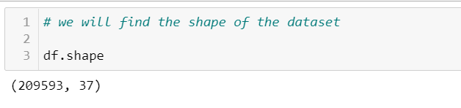
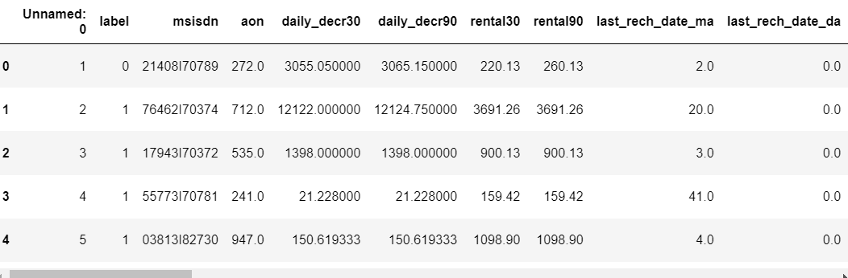
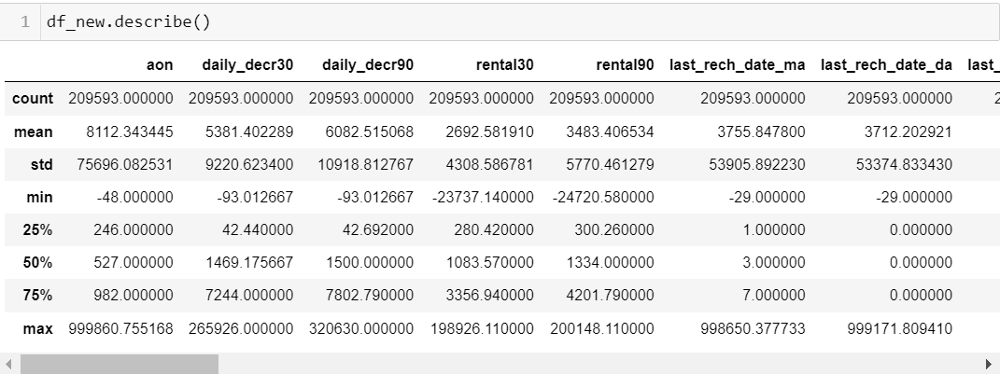
Exploratory Data Analysis
1. LOADING DATASET
2. SHAPE OF OUR DATASET HAVING
209593 ROWS AND 37 COLUMNS
3. LOOKING AT FIRST FIVE RECORDS
4. LOOKING AT STATISTICAL
PARAMETERS

Slide 11
Exploratory Data Analysis Cont...
5. NO NULL VALUES IN OUR
DATASET
6. CATERGORICAL VALUES
ARE REMOVED
7. NO. OF UNIQUE VALUES
IN OUR DATASET
8. NO. OF ZEROS IN OUR DATASET
9. ZERO IN OUR DATASET ALSO SHOW
US THAT MANY CUSTOMERS KEEP
THERE MINIMUM BALANCE ZERO.
10. REMOVING DUPLICATED
DATA

Slide 12
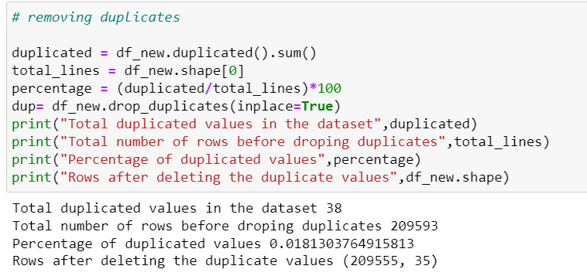
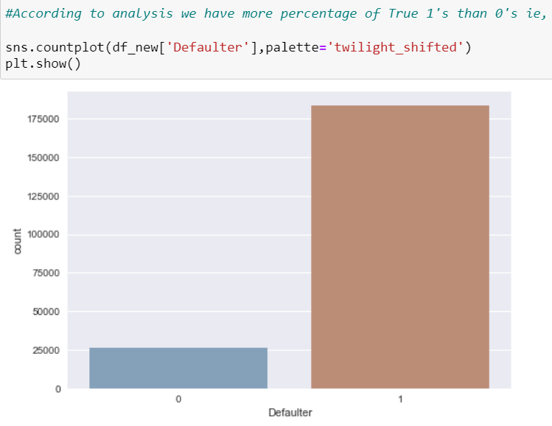
Exploratory Data Analysis Cont...
11.REMOVING DUPLICATED
DATA
12.OUR DATASET HAVE TOTAL
385 DUPLICATES AROUND
0.19%
13.SHOWING CORRELATION WITH OUR
LABEL COLUMN.
14.DATASET IS IMBALANCE
“1” IS SHOWING NO. OF
NON-DEFAULTERS AND “0” IS
SHOWING NO. OF DEFAULTERS
15.MAXIMUM CUSTOMER PAY
THEIR LOAN.

Slide 13
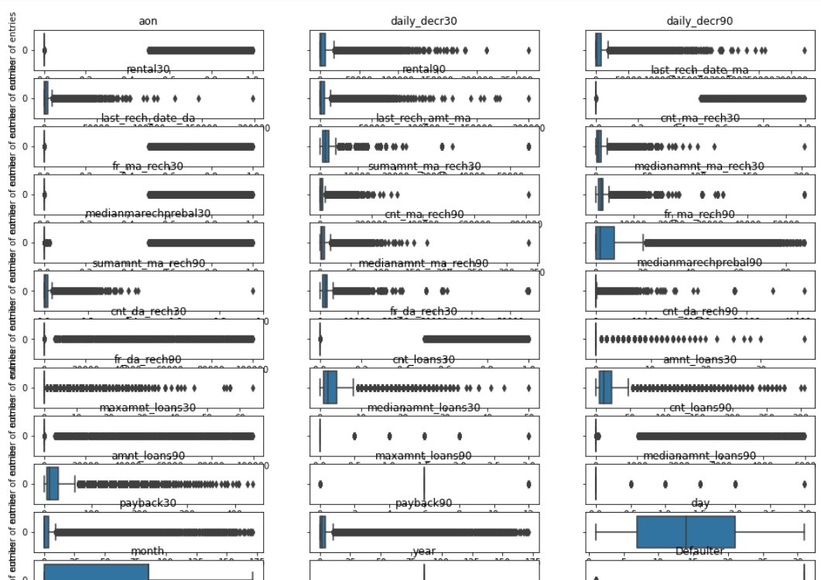
Visualizations
We will look at some of the plots that we have plotted to have more insight on understanding of our dataset.
First we will look at the boxplot to find whether we have got any outliers in our dataset.
By looking at the boxplot we found that most of the features are having outliers which has to be removed.

Slide 14
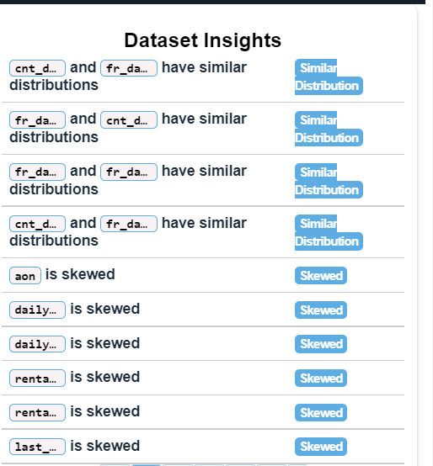
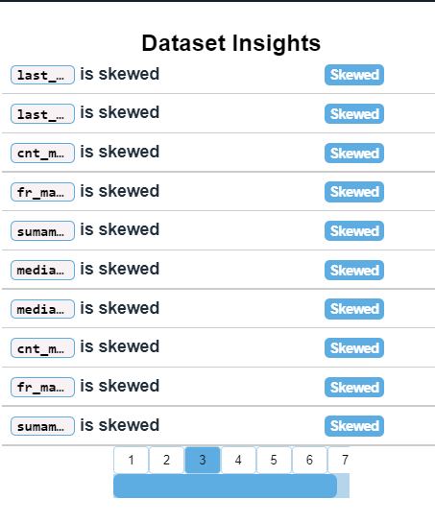
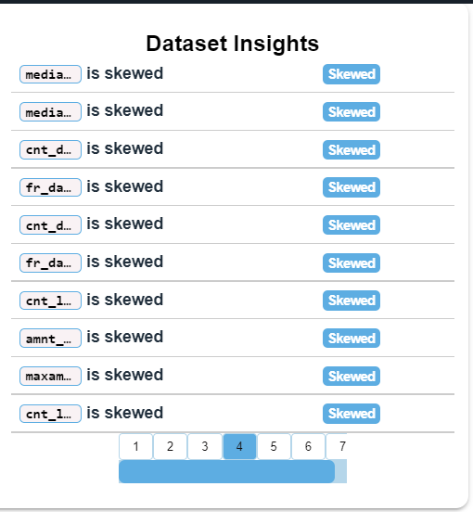
Visulization continued
We will look at some histogram to see whether any of the data are skewed and we found that following columns are having either left or right skewness

Slide 15
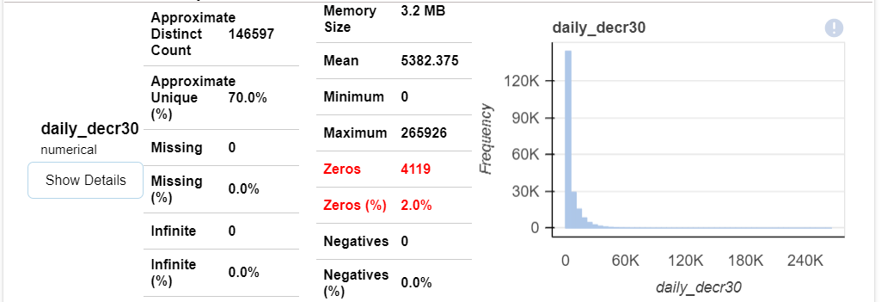
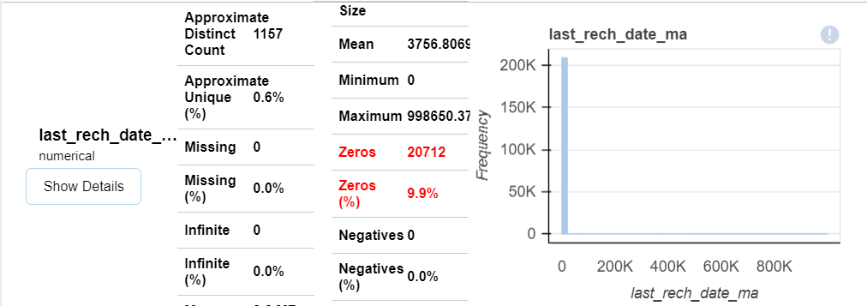
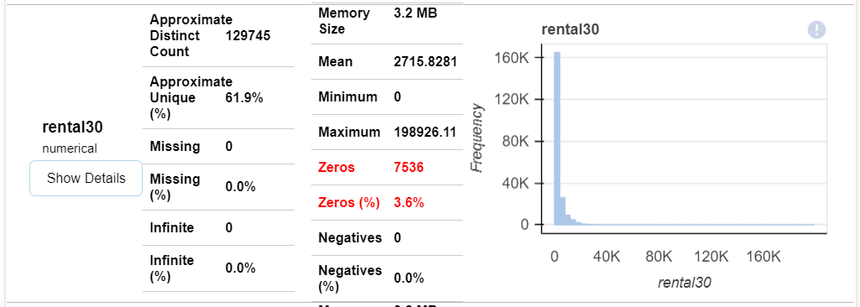
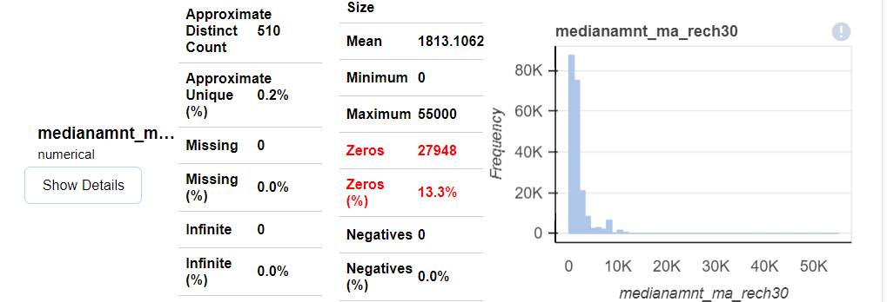
Visualization conti...
Now we will see some of the columns which are having zero values for some features.

Slide 16
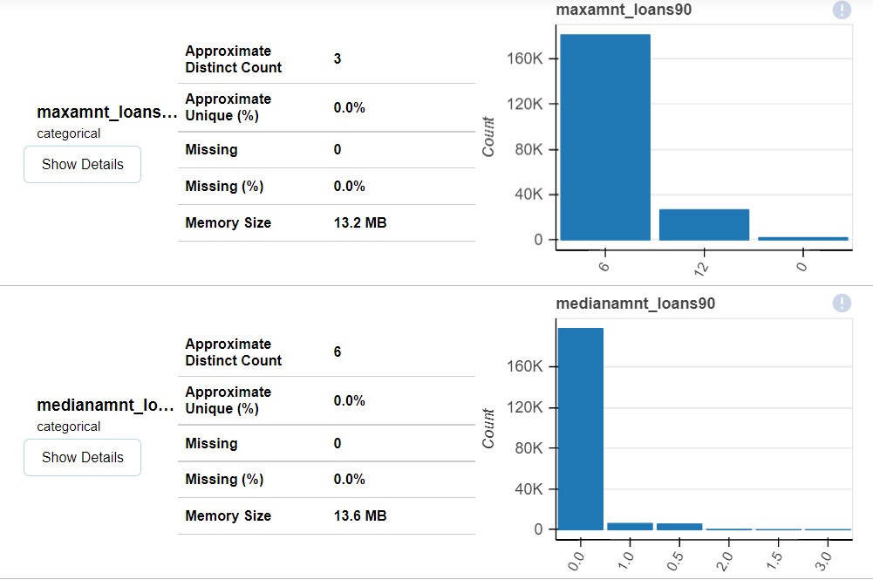
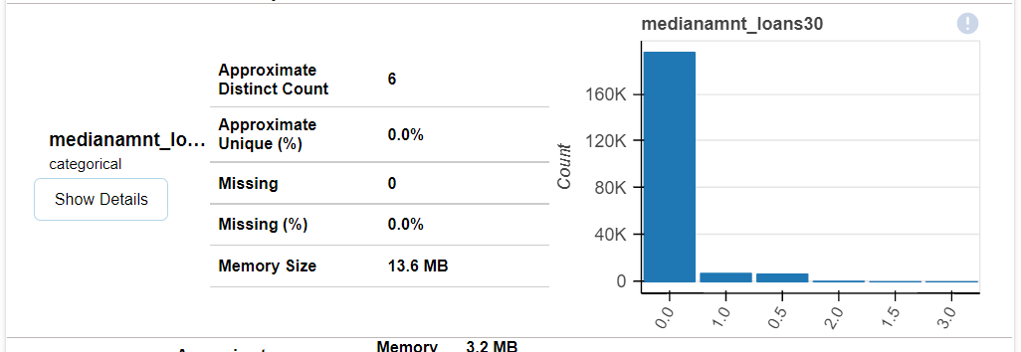
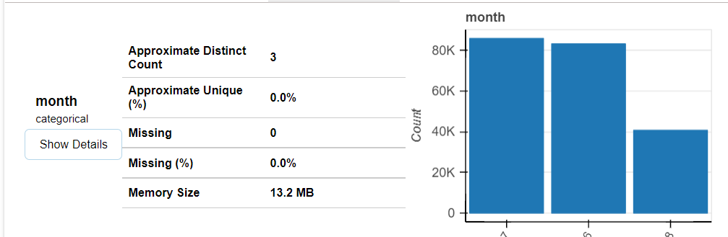
Visualization conti...
Now we will see count of the data with respect to each features.

Slide 17
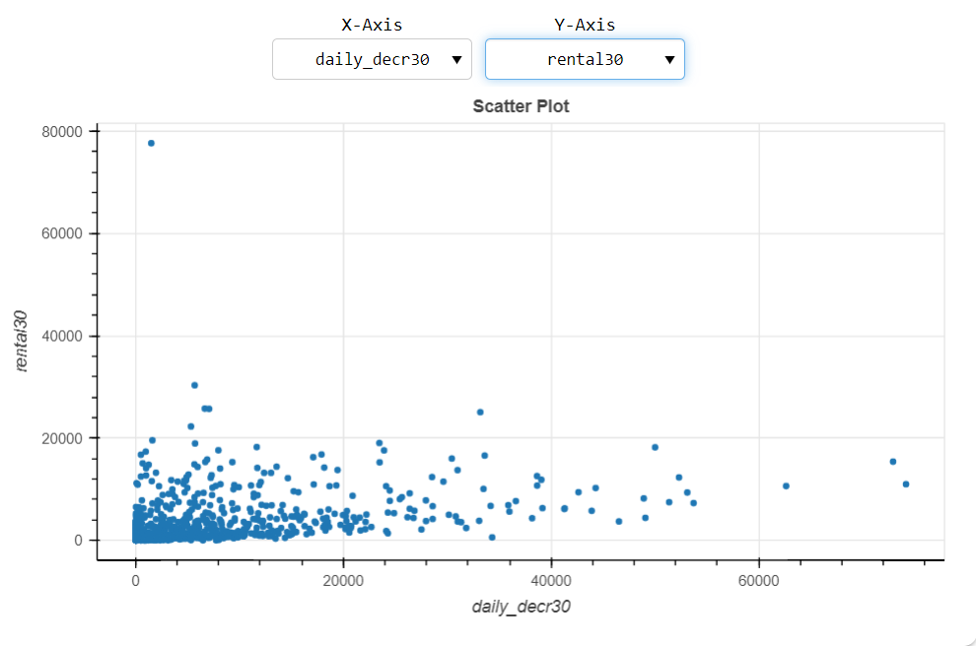
Visualization conti...
Some scatterplot to know the relationship between each of the features.
Average main account balance over 30 days remains within certain range for Daily amount spent from the main account suggesting that the average balance will be within 20000 no matter whether the customer as spent it except some exceptional cases.

Slide 18
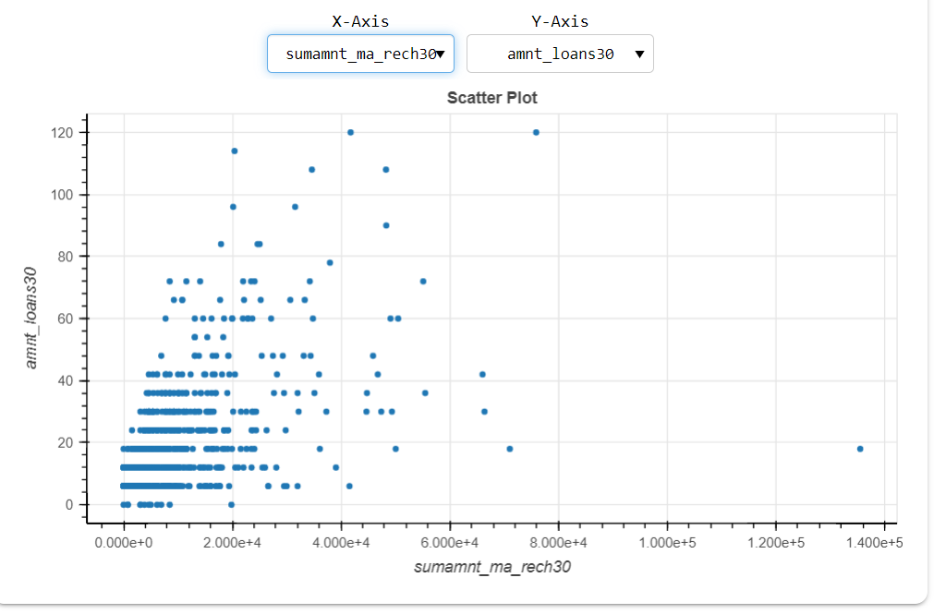
Visualization conti...
Some scatterplot to know the relationship between each of the features
Total amount of recharge in the main account shows some pattern for the amount of loan taken by user in last 30 days.

Slide 19
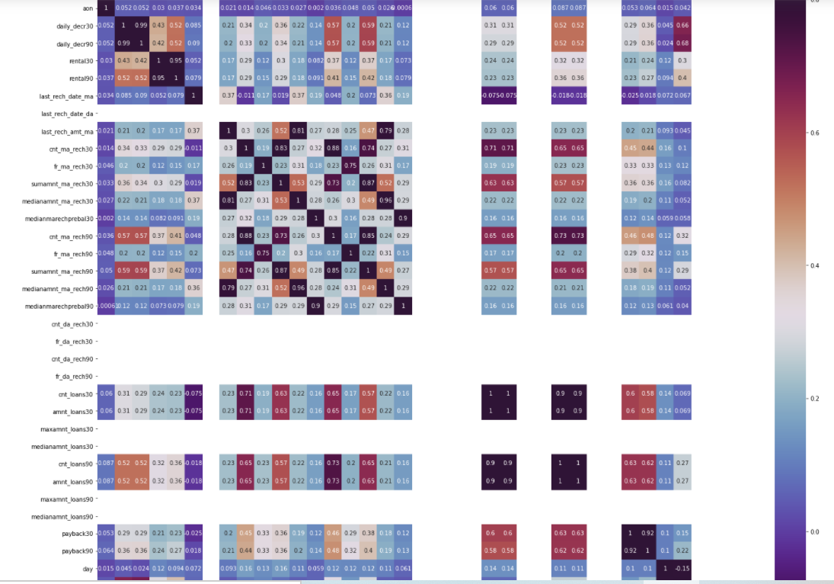
Visualization conti...
Heatmap to know the corelation with each of the features with Target variable
Some of the features is showing no variance in the dataset which is not usefull for our modelling hence we will drop those columns and the one column aon which is having negetive corelation with most of the columns.

Slide 20
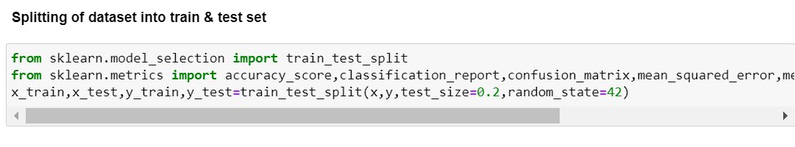
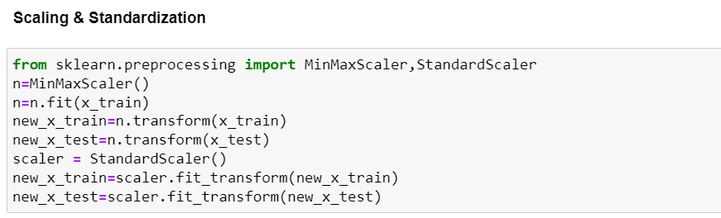
Data Modelling

Slide 21
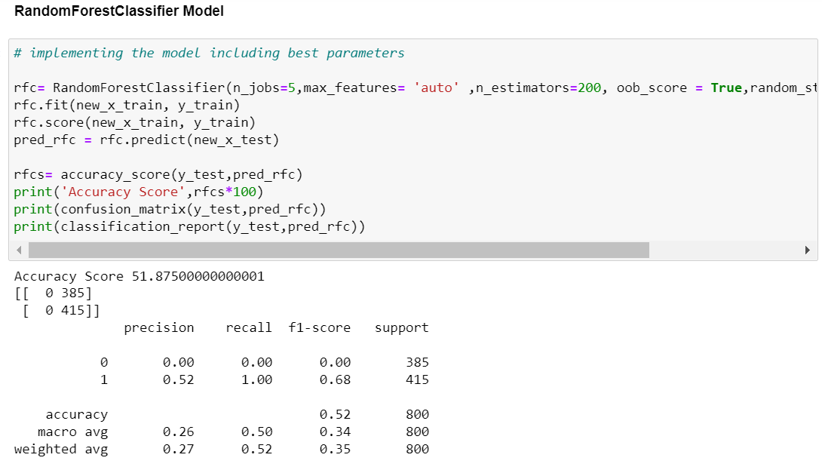
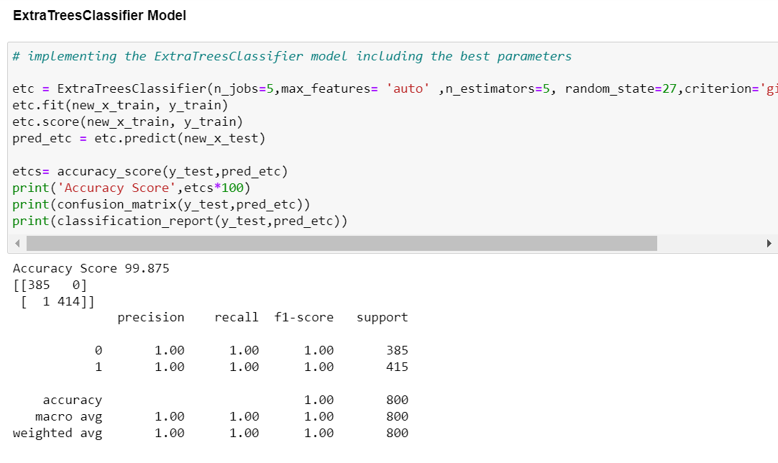
Data Modelling

Slide 22
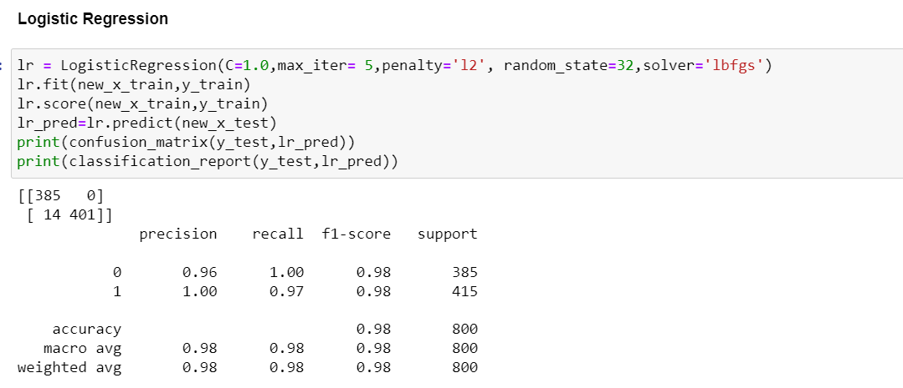
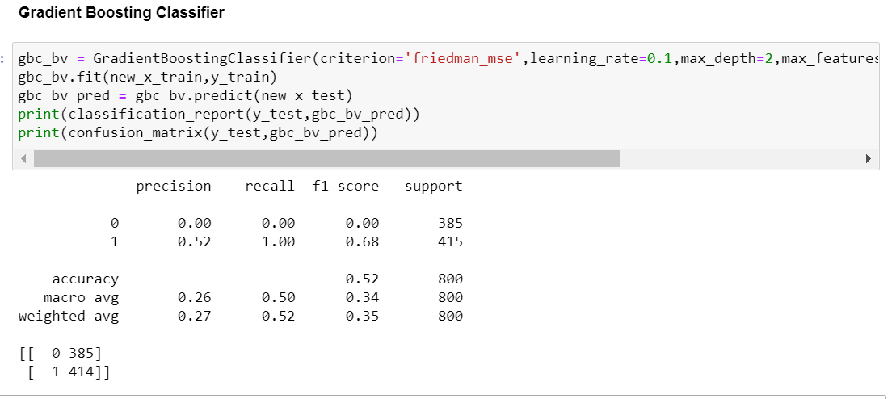
Data Modelling

Slide 23
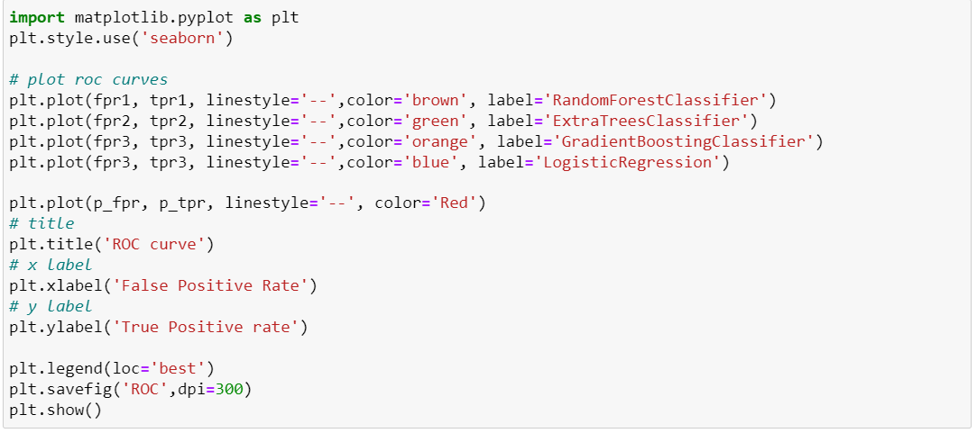
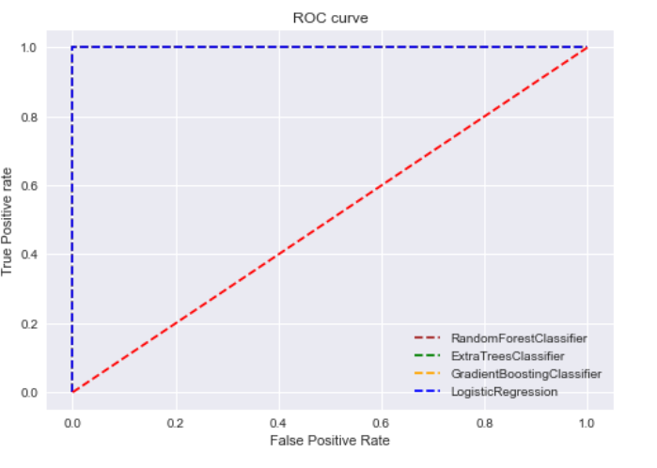
Plotting roc curve of best model

Slide 24
THANKS

